Slide 1


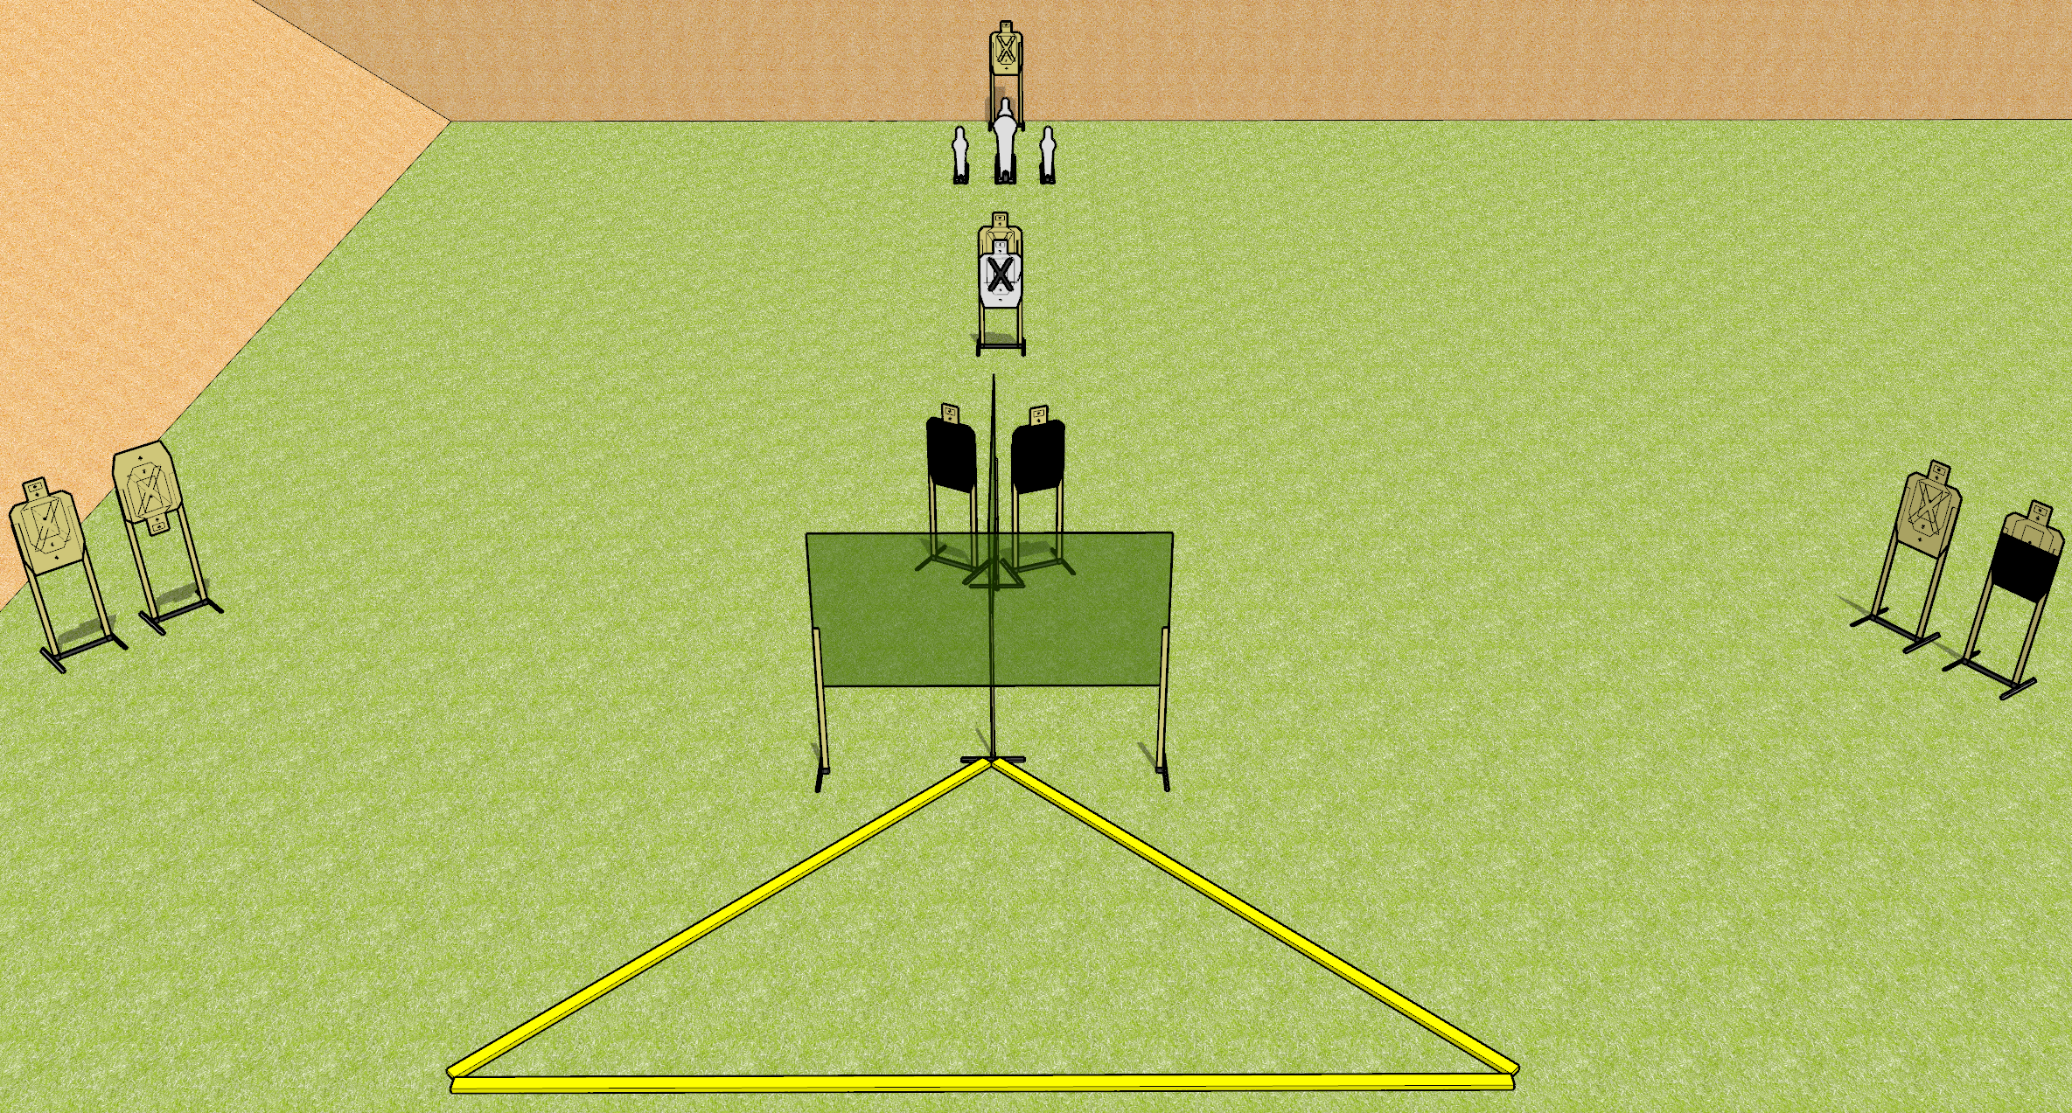
 | Dothan Gun Club – USPSA Match One Ping Only, Vasily Course Designer : Drew Coleman
START POSITION : Toes touching the rightmost or leftmost wall foot, wrists below belt.
GUN READY CONDITION : Pistol loaded and holstered. PCC loaded, shouldered, safety on, pointed in a safe direction |  | SCORING: Comstock, 12 rounds TARGETS: 8 paper, 4 Steel SCORED HITS: Best 2 on paper, steel until down START-STOP: Audible, last shot RULES:
STAGE PROCEDURE: Engage targets as they become available from within the fault lines.

Slide 2
One Ping Only, Vasily
Written Stage Briefing
One Ping Only, Vasily is a 12 round, 60 point, Comstock short course. There are eight USPSA targets, one Colt popper, and three mini poppers. The best hit on paper will score, and steel must fall to score.
Handgun start position is standing with toes touching leftmost or rightmost wall foot, wrists below belt. Handgun is loaded and holstered.
PCC start position is standing with toes touching the leftmost or rightmost wall foot. Loaded carbine is held with both hands, safety on, pointed in a safe direction.
On start signal, engage targets as they become available from within the fault lines.

